Slide 1
Copilot for Microsoft 365 Your AI assistant at work

Slide 2
The world is changing
Industries are transforming rapidly
The drivers for economic growth are evolving
Technology is at an inflection point

Slide 3
Generative AI technology is here
Time to reach 100M users
100M
Mobile phones: 16 years
ChatGPT: 3 months
50M
Internet: 7 years
Facebook: 4.5 years
16 years
3 months
Source: Microsoft Research

Slide 4
And the impact is real
Global GDP and technological revolutions
Real GDP in trillions of 2011 GK$, logarithmic scale
Cloud
Smartphone
Internet
+AI
100
PCs
Transistors
Synthetic fertilizer
Flight
10
Internal combustion engine
Mass production and assembly lines
Mass steel production
Electrification
Telegraph
1
Steam engines
Printing press
0
1000
1100
1200
1300
1400
1500
1600
1700
1800
1900
2000
GDP growth multiplier per century
0.4x
1x
1x
2x
4x
20x
Source: Maddison Project, Ourworldindata

Slide 5
Early findings – Microsoft 365 Copilot
Internal Microsoft 365 Copilot users across Sales, IT, HR, Engineering, and Marketing
87% agree more productive¹
79% focus on more important work
70% able to stay in the flow
69% focus on more satisfying work
79% spent less time on mundane tasks
How much is Copilot worth to users?
All Up Value
96% would be disappointed if they no longer had access to Copilot
83% would not want to go back to working without Copilot
47% access to Copilot would influence my choice of employer
81% allows to spend less time searching for information
73% makes meetings more efficient
79% allows me to spend less time processing email
94% makes all easier to get started on a first draft
Value by Workflow
1 in 3 had >30 min time savings per day (MCAPS)
88% complete tasks faster (MCAPS)
63% simplify complex tasks (MCAPS)
58% reclaim time for more important work (managers)
Value by Role / Function
Source: PRELIMINARY findings from Survey of MS internal users of Microsoft 365 Copilot, n-size 155 Oct 9, 2023. 1) Respondents were asked, To what extent do you agree with the following statement: when using Copilot, I am more productive.

Slide 6
Is Copilot worth more than a free lunch?
If offered the choice, users overwhelmingly said they would pick Copilot
Monthly lunch
Bi-weekly lunch
Weekly lunch
Source: Survey of Copilot for Microsoft 365 Early Access Program users, October 2023.

Slide 7
Microsoft Work Trend Index
http://aka.ms/wti
31,000 people
31 countries
Microsoft 365, LinkedIn, Glint People Science + academic research

Slide 8
Digital debt is costing us innovation
64%
of employees don’t have enough time or energy to do their job
57%
of employees' time is spent communicating
43%
of employees' time is spent creating
Source: 2023 Work Trend Index

Slide 9
Stat
87%
of organizations believe AI will give them a competitive edge
Source: MIT Sloan Management Review

Slide 10
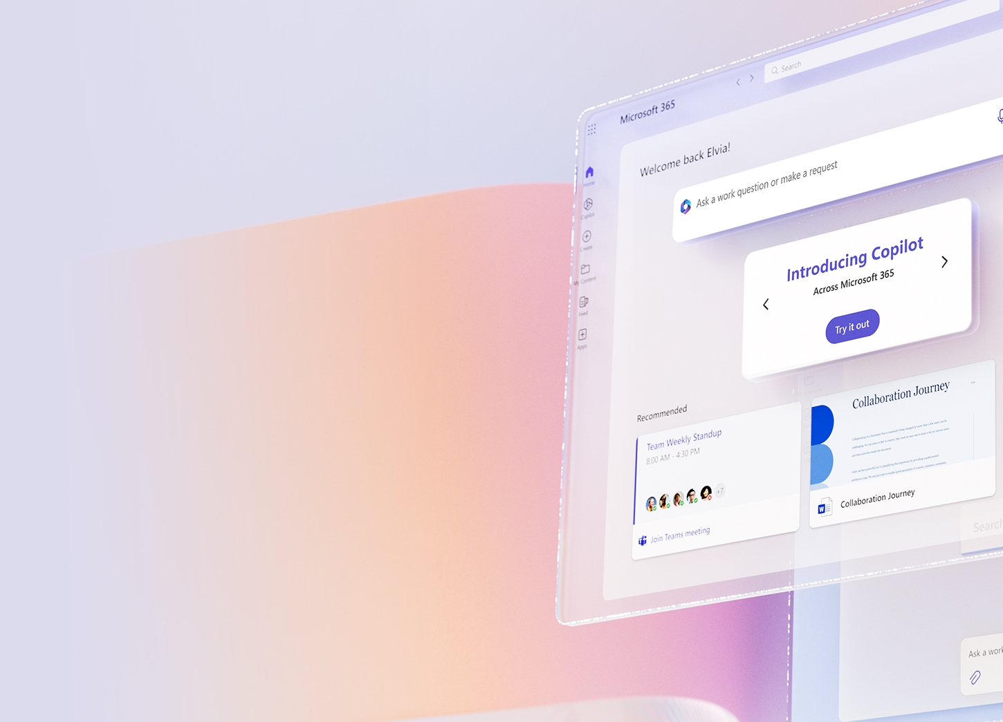
Employees and leaders are ready to embrace AI
2x
64%
70%
likelihood of a leader to say AI will provide value by boosting productivity versus cutting headcount
of employees lack time and energy to do their job
of employees willing to delegate work to AI
Source: 2023 Work Trends Index

Slide 11
Preparing for the era of AI
What are your organization's goals for using AI?
What are your organization’s pain points that AI can address?
What are your organization's current capabilities in terms of AI?
Does your organization have a data strategy in place?
Does your organization have the necessary infrastructure and resources to support AI initiatives?

Slide 12
Microsoft’s AI principles
Microsoft Cloud — AI you can trust
Fairness
Reliability & Safety
Privacy & Security
Inclusiveness
Your data is your data.
Your data is not used to train the OpenAI foundation models without permission.
Transparency
Your data is protected by the most comprehensive enterprise compliance and security controls.
Accountability

Slide 13
The AI-powered organization
01
02
Foundational productivity
Copilot for Microsoft 365

Slide 14
The AI-powered organization
01
02
Foundational productivity
Copilot for Microsoft 365

Slide 15
The AI-powered business
01
Foundational productivity
Get AI-ready checklist
Empower employees with secure, AI-powered tools
Introduce employees to secure generative AI with Microsoft Copilot with commercial data protection to prepare them for the future workplace.
Standardize onto Microsoft 365
Enrich your Copilot for Microsoft 365 experience by getting your data into the Microsoft 365 Cloud.
Organize sensitive business data
Protect internal data from accidental leakage. Ensure users have the right access to the right internal content.

Slide 16
Get Ready for Copilot for Microsoft 365
Empower employees with secure, AI-powered tools
Organize sensitive business data
Standardize on M365
Start using Gen AI with Copilot
Migrate Data to Cloud
Optimize your data management and security practices
Immediate Customer Value
Microsoft Copilot with commercial data protection for users signed in with Entra ID at no additional cost
Migrate/upgrade to cloud – Exchange Online, Teams, SharePoint online, Microsoft 365 apps
Protect business data from external threats with Identity & Endpoint
Train users on using AI in the workplace for faster ROI realization
Create and build your graph for a more relevant experience with Copilot for Microsoft 365
Manage data retention and labeling for safer AI use internally
Long Term
Value
Inoculate your customer base against competitor solutions
User adoption & change management
Partner Opportunity
Acquire new customers
Data Migration Services
Upsell to M365 Business Premium
Security Managed Services

Slide 17
The AI-powered organization
01
02
Foundational productivity
Copilot for Microsoft 365

Slide 18
Unlock productivity and unleash creativity
Copilot for Microsoft 365
Natural Language
Large Language Models
Microsoft Graph - Your Data -
Microsoft 365 Apps
The Internet

Slide 19
Copilot for Microsoft 365
Built on Microsoft’s comprehensive approach
Security
Compliance
Privacy
Responsible AI

Slide 20
Focus on what matters most
Running your business
Growing your customers
Building your brand
Scaling securely

Slide 21
Copilot for Microsoft 365
Copilot for Microsoft 365
Embedded across Microsoft 365 apps

Slide 23
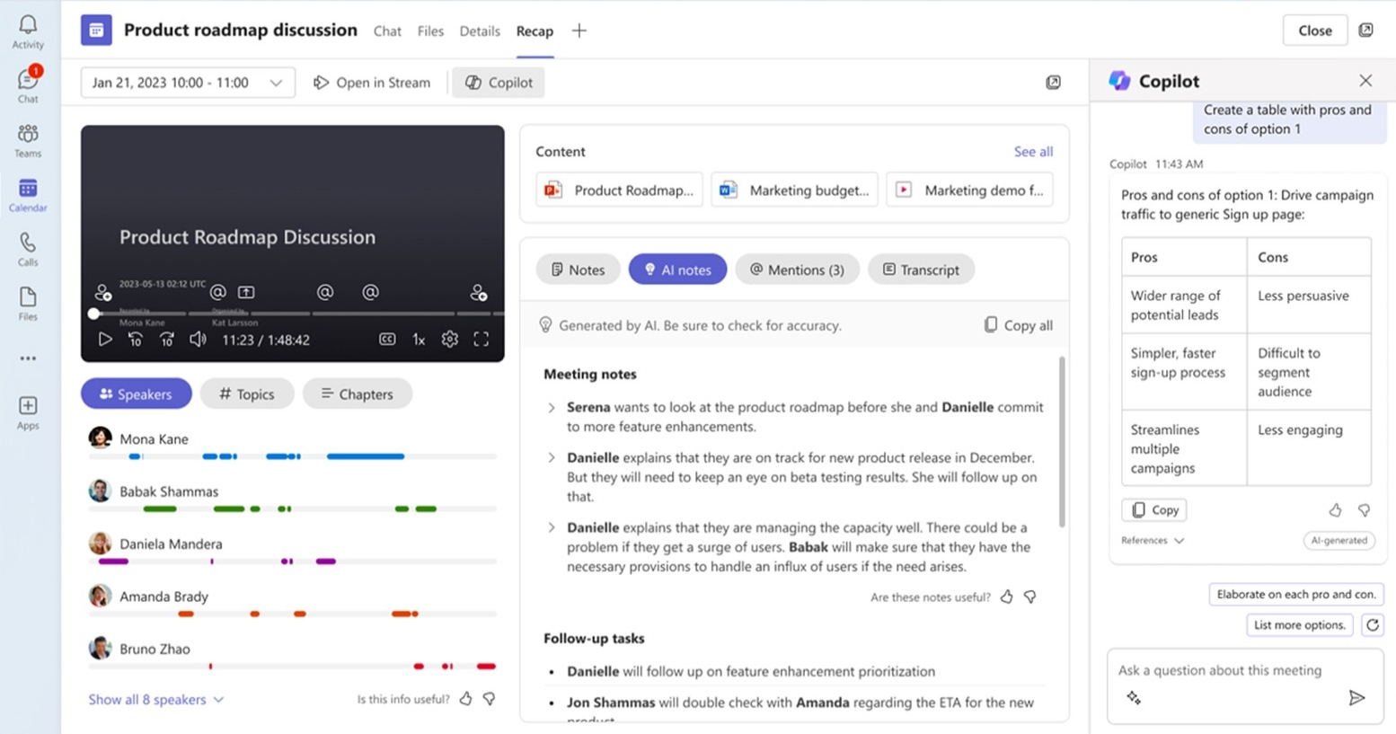
Intelligent recap in Copilot
Intelligent recap
Copilot in Teams
Built-in and automated
On-demand
Standardized
Based on unique prompts
Video, speaker, and chapter markers
Conversational interaction, with citations
Available after meeting only
Available real-time (during & after meeting)
Use built-in meeting summaries and ask any question about the meeting
*Intelligent recap is also available in Teams Premium

Slide 24
Notes:
Copilot in Outlook
Coming soon to Copilot in Outlook, you can follow a Teams meeting that you’re unable to attend right from Outlook. When the meeting starts, Teams notifies the organizer to record it. When the recording is ready, Copilot notifies you that the meeting recap is ready for viewing, directly in Outlook. You’ll soon be able to use the Copilot Chat in Outlook to ask questions or get a summary without leaving your inbox.

Slide 26
Copilot in Excel

Slide 29
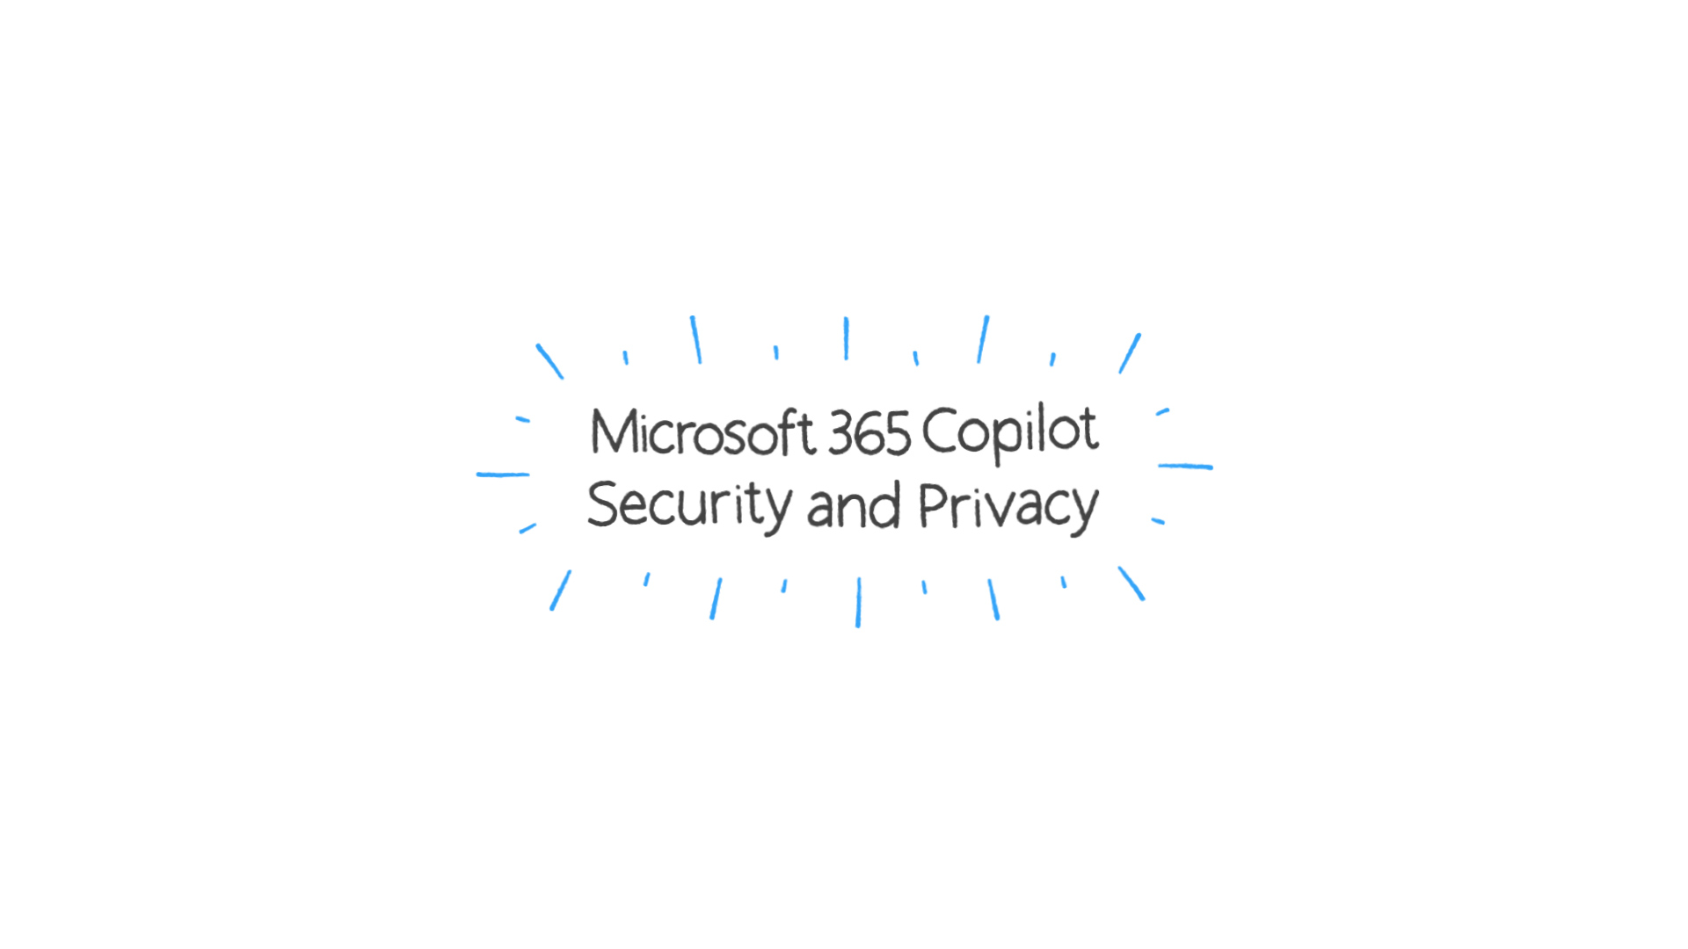
Microsoft 365 Copilot Security and privacy

Slide 30
Security and Compliance controls for Copilot for Microsoft 365
Essential security controls
Comprehensive security controls
Copilot +
M365 Business Standard
Copilot +
Microsoft 365 Business Premium
Multi-factor Authentication
with security defaults
Device-based access & security controls
for M365 resources
Basic content and keyword search
for Copilot generated data
Everything in M365 Business Standard, plus:
Conditional Access policies based on identity, device, location, & network
Terms of use policies to accept before getting access
Restrict saving business data and files to approved applications only
Protect sensitive M365 data from exfiltration and improper use (files & emails only)
eDiscovery, litigation hold and retention policies
Note: Not all features/products shown.

Slide 31
Microsoft’s AI principles
Microsoft Cloud — AI you can trust
Fairness
Reliability & Safety
Privacy & Security
Inclusiveness
Your data is your data.
Your data is not used to train the OpenAI foundation models without permission.
Transparency
Your data is protected by the most comprehensive enterprise compliance and security controls.
Accountability

Slide 32
Early Access Program
Faster, Better, Easier
I do believe that there isn't a single job position in the company that won't benefit in some way from Copilot being available to them.
- Alex Wood, Senior Cloud Engineer
I no longer need to spend time consolidating meeting notes, Copilot does it for me. I'm saving at least 10 minutes of time with each meeting.
- Mahesh Patil, CTO of DLT Apps
I’m really impressed with how Copilot works in Outlook. I had it generate several emails for me, and it did a really great job. All I had to do was add my own details and they were ready to send.
- Paul Birkin, Chief Operating Officer

Slide 33
Jetzt Copilot bei QualityHosting bestellen
Learn how AI is poised to create a whole new way of working
Leverage Getting started content as well as Resources for Adoption
Delve into security, privacy and compliance
Get better acquainted with the art of prompting with Copilot Lab
How can you get started?

Slide 34
Thank You!

